Slide 1

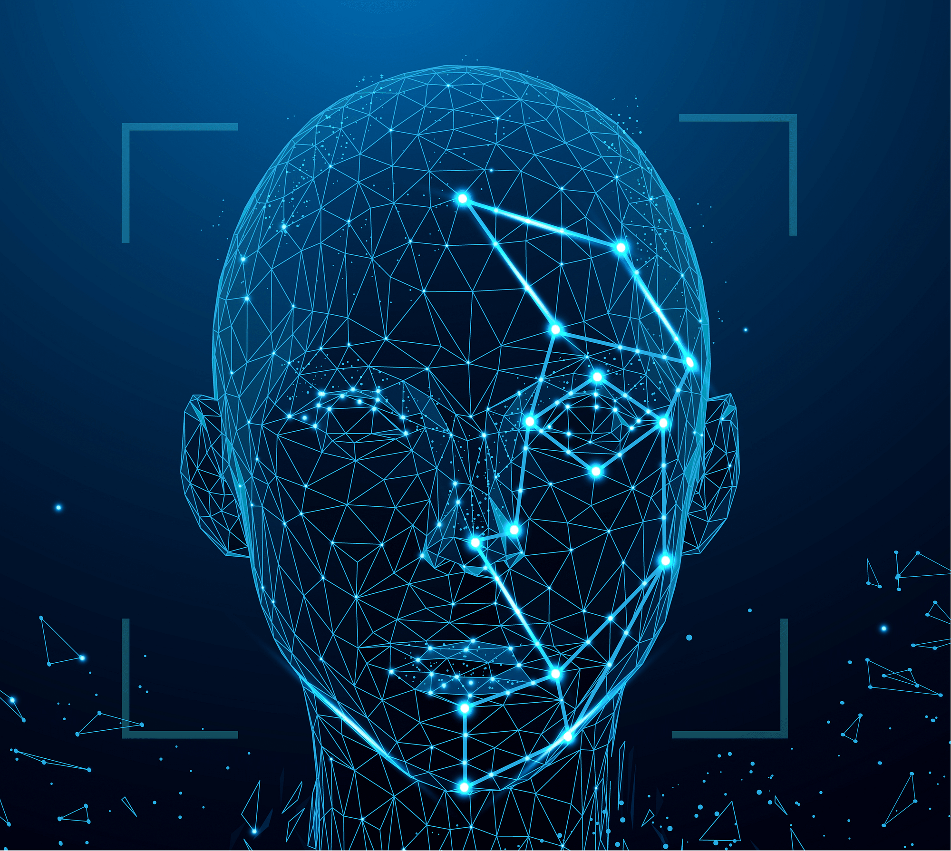




FACIAL AUTHENTICATION SYSTEMS
PROJECT
By Wala Marzouki

Slide 2
TABLE OF CONTENTS
Introduction: Definition, concept, and levels
Historical Background
How Facial Authentication Works
Facial Recognition Algorithms
Applications of facial authentication
Conclusion: SWOT Analysis

Slide 3


DEFINITION AND CONCEPT
Facial recognition is a category of biometric security to identify or confirm an individual’s identity using their face in photos, videos, or in real time.
It is a technology that uses deep learning and artificial intelligence (AI) to match a human face from a digital image against a database of faces. Such a system is typically employed to authenticate users through ID verification services and works by pinpointing and measuring facial features from a given image.
In comparison to other physiological and behavioral biometrics, biometric facial recognition offers a reliable authentication compelling blend of accuracy, convenience, and non-intrusiveness and offers a more convenient and user-friendly experience as it does not require physical contact.
This makes it well-suited for a wide range of applications where security, efficiency, and user experience are of paramount importance.
According to a 2021 reportOpens a new window by NIST (the National Institute of Standards and Technology at the U.S. Department of Commerce), facial recognition algorithms now have an average error rate of just 0.08%, compared to the 4.1% in 2014.

Slide 4




ANY GOOD FACIAL AUTHENTICATION SYSTEM HAS THREE KEY COMPONENTS:
HARDWARE
to capture the images. These images can also be fed into the software from independent devices.
INTELLIGENCE AND ALGORITHM
to compare the captured faces with existing data.
DATABASE
an existing collection of identities.
Face recognition can be sub-categorized into ‘face verification’ and ‘face identification’.
Face verification answers the question “is this person who he/she claims to be?”
Face Identification answers the question “who is this person?”

Slide 5


There are multiple “levels” of facial authentication that provide corresponding levels of protection. , let’s have first a look at the two larger dimensions of this biometric authentication method: DEVICE-SIDE VS. SERVER-SIDE AUTHENTICATION.
In device-side authentication, each of the steps of facial authentication — analysis, biometric template creation, storage, and matching — all take place locally on a user’s device.
When applying server-side authentication, a user’s biometric data is entered and centrally stored within a secure server instead of their device. Whenever they attempt to verify their identity using facial biometrics, their biometric sample is sent to the centralized matching engine, where it’s paired up against the data template that was previously stored. When onboarding a new user, the biometric template is usually entered based on prior identity verification
01
02

Slide 6



LEVELS OF FACIAL AUTHENTICATION
FACIAL LIVENESS DETECTION
GENUINE PRESENCE CHECK
FACIAL RECOGNITION
can be defined as the use of technology to detect the harmless presence and vital signs of a live user, rather than a picture, a fake video, or a mask. Simply put, after a user scans their face, liveness detection technology will verify whether or not the source is coming from a fake representation.
is a high-level way to make sure it's really you. It uses a live video and asks you to do something specific, like smile or blink, to prove you're there in real-time. This helps verify that the person trying to do something is actually there at that moment, not just using a photo or video.
This is the simplest — and least secure — form of facial authentication. Facial recognition does exactly what it sounds like: it recognizes one’s face.

Slide 7
The team of two was able to prove how any face can be approximated through a combination of a few sets of Eigenfaces. Facial recognition started to gain popularity and attention in the early 1990s when government agencies such as the Defense Advanced Research Projects Agency (DARPA) and the National Institute of Standards and Technology (NIST) showcased a Facial Recognition program to kickstart the facial recognition commercial market.
In 1991, Pentland and Turk worked further on the Eigenfaces approach by finding ways to detect faces within images. Pentland and Turk’s work was the first automatic face recognition attempt. They used technological and environmental factors for their approach. Probably the most important turning point came in 2001 when Paul Viola and Michael Jones proposed a framework for object detection that achieved success rates never seen before. Their algorithm was based on the combination of the use of fast computing features (HAAR features) with an optimised training process. In this way it was possible to detect the face quickly and reliably, and to isolate areas of the image in order to apply more powerful descriptors.
HISTORICAL BACKGROUND
Facial Recognition dates back to the 1960s, it was invented by American Mathematician Woody Bledsoe. He creates the first facial ID system using a RAND tablet. The system he created would organize the photos of faces by hand. People made use of this technology and manually recorded the coordinate areas of the features like the hairline, mouth, nose, eyes, and the structure. The accuracy and precision of facial recognition progressed throughout the 1970s to 1990s.
in 1970s Harmon, Goldstein, and Lesk worked on the manual facial recognition technology and converted it into automatic detection. They used 21 facial markers that included the thickness of the lip and the color of the hair, even – these markers were used to make detection of faces automatic and more accurate. Linear algebra was included to detect faces in 1988 by Sirovich and Kirby. This particular approach was named Eigenface. The focus was to search for low-dimensional facial images representations.

Slide 8
One of the first corporate implementations of facial recognition software was in 2010, when Facebook used it as a feature to recognize users in photos that other users upload. Facebook continues to use this feature to this day.
This brings us to the more modern and advanced versions of facial recognition technology. In 2017, Apple released the iPhone X. It features a recognition system called Face ID which is used to unlock the user's device and make payments.
In recent years the most relevant advances in the field of face recognition have been made by the use of deep learning environments. Unlike classical methods, deep learning algorithms through the learning process create their feature extractors by analysing complex relationships between the input data set.

Slide 9

HOW FACIAL AUTHENTICATION WORKS
There are a wide variety of software, whether it is a Face API like Microsoft’s or a library like OpenCV, that makes face detection and recognition accessible and reliable and is constantly improving. Every facial recognition system works differently—often built on proprietary algorithms—but you can sort out the process into three basic steps
Detection
is the process of finding a face in an image not the identity behind it. It involves distinguishing facial features from the surrounding environment and pinpointing their location within the frame. Common algorithms like Haar Cascade, Viola-Jones, and deep learning-based techniques are used for accurate face detection.
01

Slide 10
Analysis
because A computer does not see a face as a collection of colors, shapes, and features, but rather as a matrix of numbers., this step is about mapping faces—often by measuring the distance between the eyes, the shape of the chin, the distance between the nose and mouth, etc. These numbers are arranged so that each one describes the lightness or darkness of a certain pixel.
Popular methods used for this mapping include Local Binary Patterns (LBP), Histogram of Oriented Gradients (HOG), and Convolutional Neural Networks (CNNs). then converts that into a mathematical representation, often called a “called face encoding” Deep learning models like Siamese networks or Triplet Loss networks are often used for this purpose.
Most facial recognition technology relies on 2D rather than 3D images because it can more conveniently match a 2D image with public photos or those in a database.
02
Recognition
is the attempt to confirm the identity of a person in a photo.The face encoding is compared with previously stored face encodings in a database. To assess the similarity between both databases, the system computes a similarity score. Various algorithms, such as Euclidean distance or cosine similarity, are employed to calculate the similarity between face encodings.
A higher score signifies a closer match between facial features, thereby confirming the individual’s identity with greater certainty. Based on the computed similarity score and predetermined thresholds, the system makes a decisive determination to either grant or deny access to the user.
03

Slide 11



FACIAL RECOGNITION ALGORITHMS
A face detection and recognition system's fundamental part is a face recognition algorithm. Face recognition algorithms come in a variety of forms, including deep learning-based and traditional feature-based algorithms that require human feature design.
Face recognition algorithms typically perform the following main tasks:
Detect faces in images, videos or live streams
Compute a mathematical model of the face image
Compare the model derived from a face to an image in a training set or database
Evaluate the comparison to see whether the face shows the required individual

Slide 12
Some face recognition algorithms identify facial features by extracting landmarks, or features, from an image of the subject's face. For example, an algorithm may analyze the relative position, size, and/or shape of the eyes, nose, cheekbones, and jaw. These features are then used to search for other images with matching features. Recognition algorithms can be broadly classified into two types of approaches: photo-metric, which is a statistical technique that converts a picture into values and then compares those values with templates to remove variations, and geometric, which looks at distinguishing features. Some divide these algorithms into two major groups: feature-based models and holistic models. While the feature-based approach divides a face into components based on features and analyzes each one as well as its spatial relationship to other features, the holistic models aims to recognize the face in its whole.
Other algorithms normalize a gallery of face images and then compress the face data, only saving the data in the image that is useful for face recognition. A probe image is then compared with the face data

Slide 13
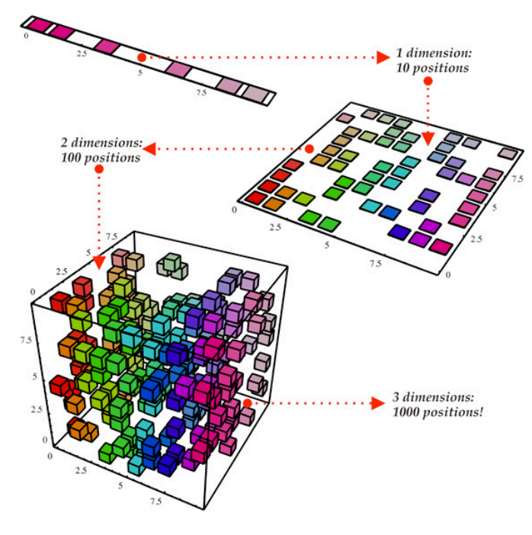
SOME OF THE MOST POPULAR ALGORITHMS INCLUDE THE FOLLOWING:
Principal Component Analysis (PCA): This is one of the earliest and simplest algorithms used for face recognition. is an activity that extracts the absolute most relevant information within a face and then tries to construct a computational model that best describes it by reducing the dimensionality of the face image while retaining its essential features.

Slide 14
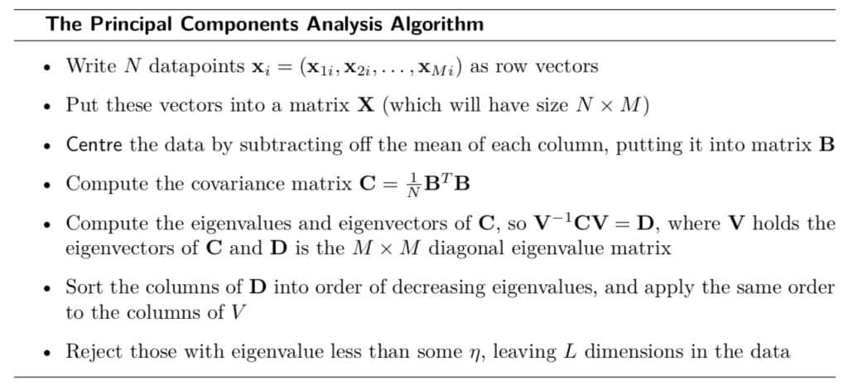

Slide 15
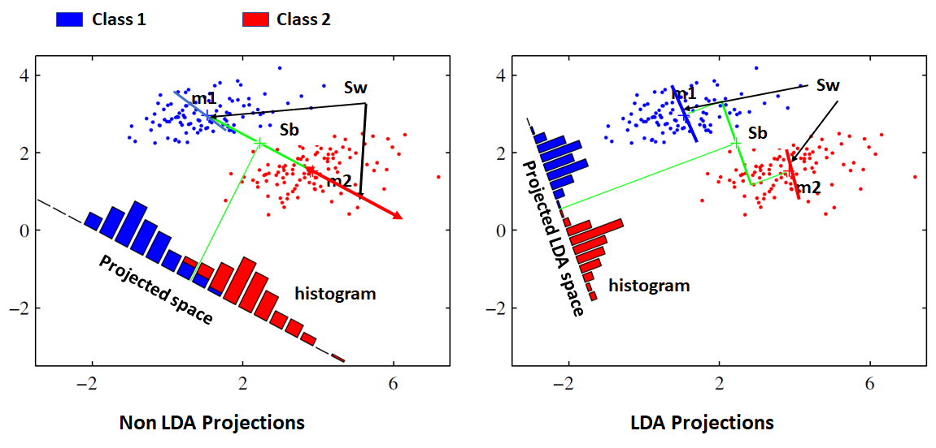
2.Linear Discriminant Analysis (LDA): This algorithm is similar to PCA, is a method used for face recognition that works by transforming face images into a lower-dimensional space. It does this by focusing on making faces from different people look as different as possible (maximizing between-class differences) while making faces from the same person look as similar as possible (minimizing within-class differences). This helps in better distinguishing between different individuals based on their facial features.

Slide 16
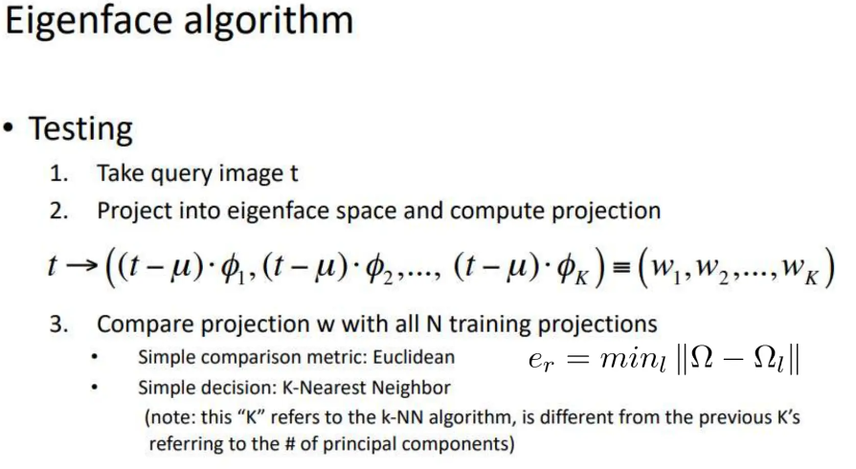
3. Eigenfaces: It was one of the earliest algorithms for face recognition and is still used today in some applications. This algorithm is based on PCA to extract features from the face image. It represents faces as a linear combination of eigenvectors, known as eigenfaces. Each face image can be represented as a combination of these eigenfaces, allowing for dimension reduction and efficient representation of facial features.

Slide 17
4. Fisherfaces: This is widely considered superior to other techniques like eigenfaces due to its focus on maximizing the separation between classes during the training process. It involves reducing the dimensionality of face space using Principal Component Analysis (PCA) and then applying Fisher's Linear Discriminant (LDA) method to extract image characteristics. The algorithm uses Fisher's Linear Discriminant to calculate between-class and within-class scatters, followed by a standard Linear Discriminant Analysis to maximize the ratio of these scatters. The final step involves obtaining Fisherfaces by combining the PCA rotation matrix with the Fisher Linear Discriminant matrix.

Slide 18

5. Convolutional Neural Network: The most common type of machine learning algorithm used for facial recognition is a deep learning Convolutional Neural Network (CNN). CNNs are a type of artificial neural network that is well-suited for image classification tasks. CNNs learn to extract features from images and use those features to classify the images into different categories. CNNs use a series of layers, each of which detects different features of an input image. Depending on the complexity of its intended purpose, a CNN can contain dozens, hundreds, or even thousands of layers, each building on the outputs of previous layers to recognize detailed patterns.
A CNN typically has three layers:
a convolutional layer
a pooling layer
a fully connected layer.

Slide 19
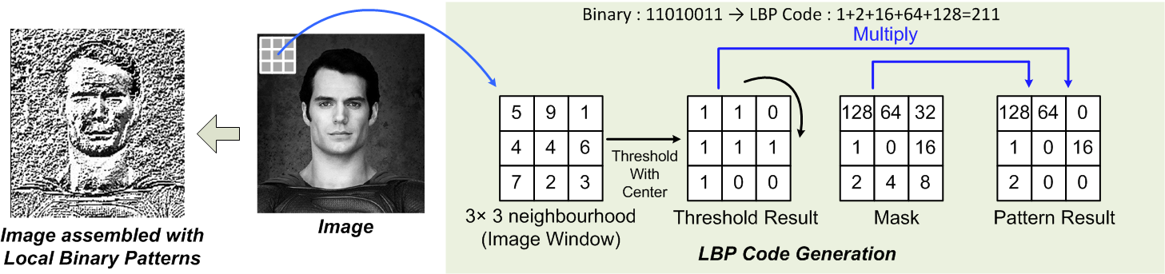
6. Local Binary Patterns (LBP): With LBP it is possible to describe the texture and shape of a digital image. This texture-based algorithm uses binary patterns of pixels to represent faces. This is done by dividing an image into several small regions from which the features are extracted. These features consist of binary patterns that describe the surroundings of pixels in the regions. The obtained features from the regions are concatenated into a single feature histogram, which forms a representation of the image. Images can then be compared by measuring the similarity (distance) between their histograms.

Slide 20
APPLICATIONS OF FACIAL AUTHENTICATION
The following are some practical applications of a face recognition system:
Fraud detection: Companies use facial recognition to uniquely identify users creating a new account on an online platform. After this is done, facial recognition can be used to verify the identity of the actual person using the account in case of risky or suspicious account activity.
Cyber security: Companies use facial recognition technology instead of passwords to strengthen cybersecurity measures.
Airport and border control: Many airports use biometric data as passports, allowing travellers to skip long lines and walk through an automated terminal to reach their gate faster. Face recognition technology in the form of e-Passports reduces wait times and improves security.
Banking: Individuals authenticate transactions by simply looking at their phone or computer instead of using one-time passwords or two-step verification. Facial recognition is safer as there are no passwords for hackers to compromise.
Healthcare: Facial recognition can be used to gain access to patient records. It can streamline the patient registration process in a healthcare facility and autodetect pain and emotion in patients.
Marketing and advertising: Marketers have used facial recognition to enhance consumer experiences. For example,
Billboards that incorporate face recognition technology – such as London’s Piccadilly Circus – means brands can trigger tailored advertisements.
Tracking student or worker attendance

Slide 21
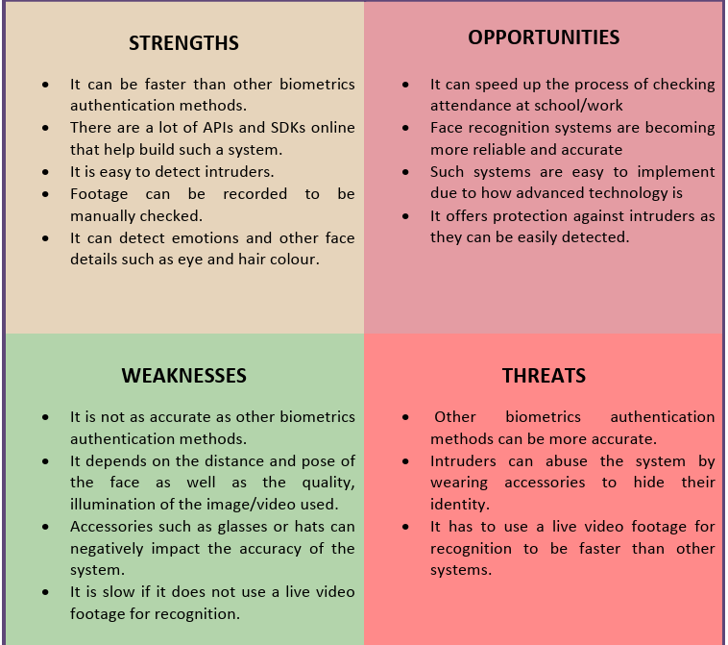
CONCLUSION

Slide 22
THANK YOU!

